Slide 1
Trees and tree algorithms

Slide 2
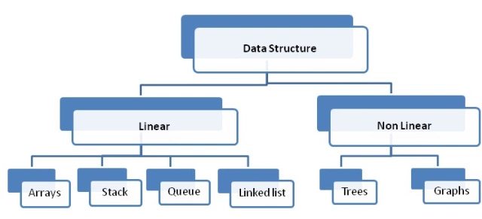
Data structures types

Slide 3
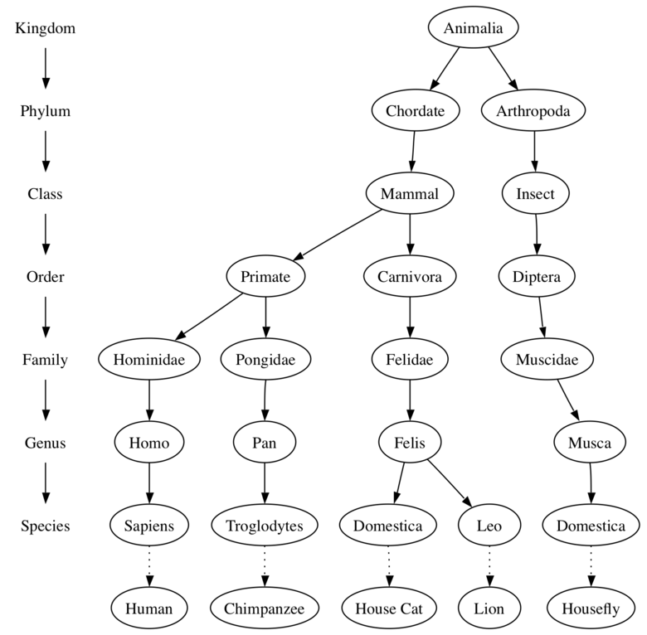
Examples of Trees
Trees are a natural way to create a hierarchical taxonomy to organize information
Trees are a common data structure in computer science
A tree data structure has a root, branches, and leaves
Trees are hierarchical
Trees are used in many areas, including operating systems, graphics, database systems, and computer networking.

Slide 4
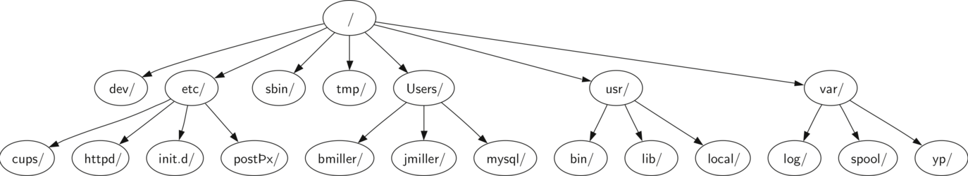
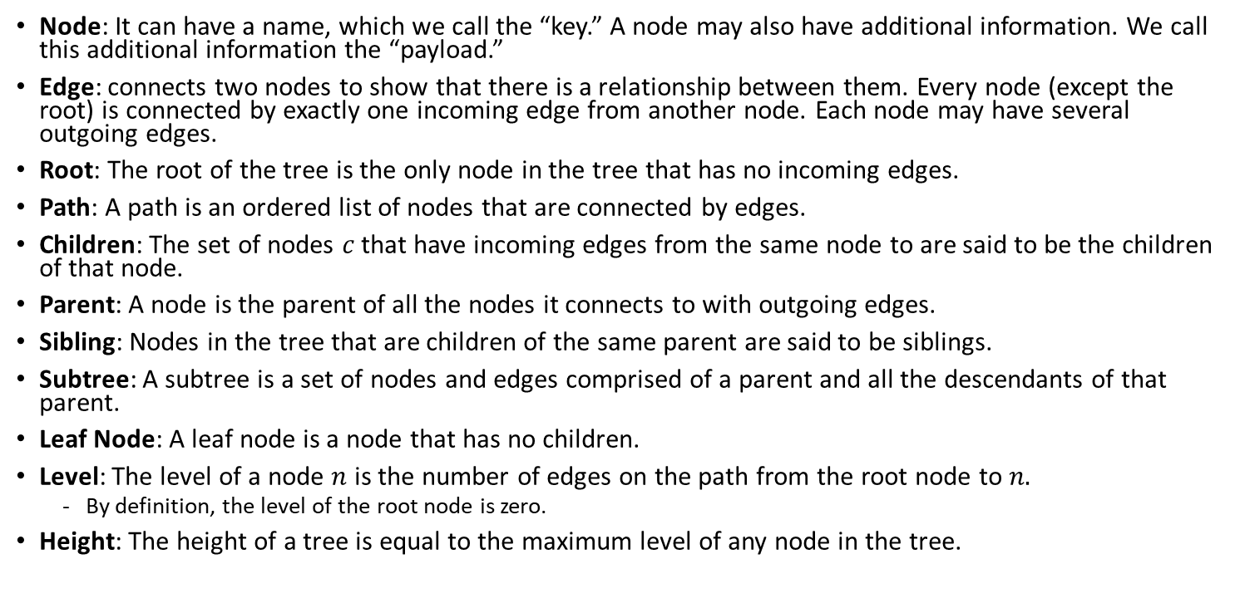
Tree terminology
Node: It can have a name, which we call the “key.” A node may also have additional information. We call this additional information the “payload.”
Edge: connects two nodes to show that there is a relationship between them. Every node (except the root) is connected by exactly one incoming edge from another node. Each node may have several outgoing edges.
Root: The root of the tree is the only node in the tree that has no incoming edges.
Path: A path is an ordered list of nodes that are connected by edges.
Children: The set of nodes $c$ that have incoming edges from the same node to are said to be the children of that node.
Parent: A node is the parent of all the nodes it connects to with outgoing edges.
Sibling: Nodes in the tree that are children of the same parent are said to be siblings.
Subtree: A subtree is a set of nodes and edges comprised of a parent and all the descendants of that parent.
Leaf Node: A leaf node is a node that has no children.
Level: The level of a node $n$ is the number of edges on the path from the root node to $n.$
By definition, the level of the root node is zero.
Height: The height of a tree is equal to the maximum level of any node in the tree.

Slide 5

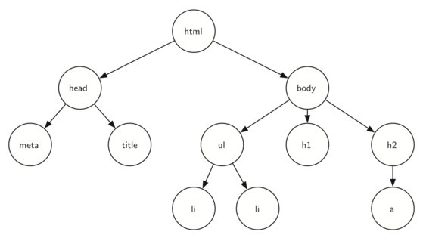
Another example of the ubiquity of trees in computer science: markup languages

Slide 6
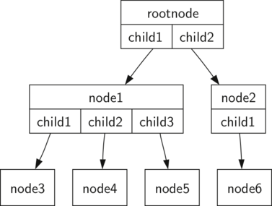
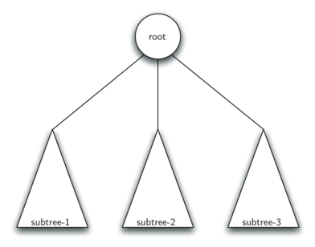
Two alternative computational definitions of a tree
Definition One: A tree consists of a set of nodes and a set of edges that connect pairs of nodes. A tree has the following properties:
One node of the tree is designated as the root node.
Every node n, except the root node, is connected by an edge from exactly one other node p, where p is the parent of n.
A unique path traverses from the root to each node.
If each node in the tree has a maximum of two children, we say that the tree is a binary tree
Definition Two: A tree is either empty or consists of a root and zero or more subtrees, each of which is also a tree. The root of each subtree is connected to the root of the parent tree by an edge.

Slide 7
Implementation of a binary tree
The key decision in implementing a tree is choosing a good internal storage technique.
Python allows us two very interesting possibilities
list of lists
nodes and references

Slide 8
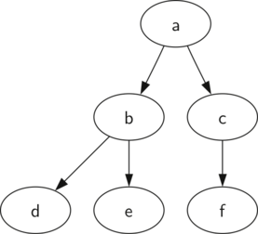
List of lists implementation of a tree
A tree represented by a list of lists provides us with a simple recursive data structure
In a list of lists tree, we will store the value of the root node as the first element of the list.
The second element of the list will itself be a list that represents the left subtree.
The third element of the list will be another list that represents the right subtree.
myTree = ['a', #root
['b', #left subtree
['d', [], []],
['e', [], []]
],
['c', #right subtree
['f', [], []],
[]
]
]

Slide 9
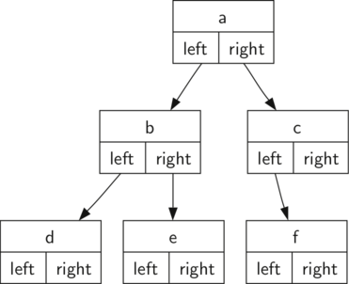
Nodes and references
Our second method to represent a tree uses nodes and references.
In this case we will define a class that has attributes for the root value, as well as the left and right subtrees.
The important thing to remember about this representation is that the attributes leftChild and rightChild will become references to other instances of the BinaryTree class.
Since this representation more closely follows the object-oriented programming paradigm, we will continue to use this representation for the remainder of the lecture
class BinaryTree:
def __init__(self,rootObj):
self.key = rootObj
self.leftChild = None
self.rightChild = None

Slide 10
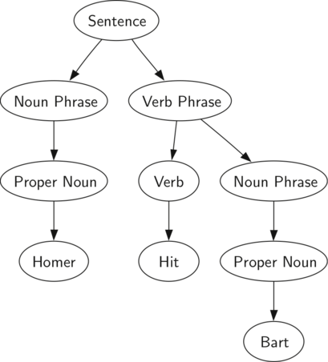
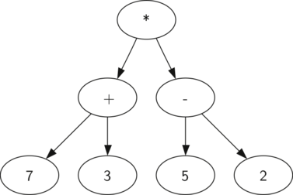
Applications of the tree data structure: Parse tree
Parse trees can be used to represent real-world constructions like sentences or mathematical expressions.
Representing a sentence as a tree structure allows us to work with the individual parts of the sentence by using subtrees.
We can also represent a mathematical expression such as ((7+3)∗(5−2)) as a parse tree

Slide 11
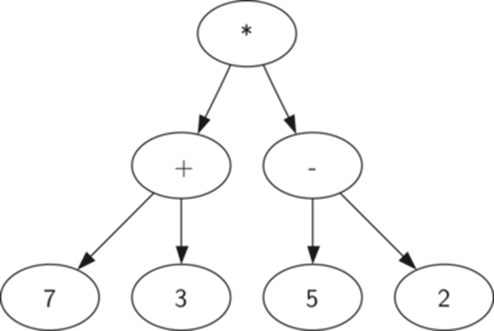
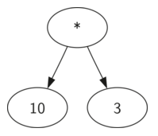

How to build a parse tree from a fully parenthesized mathematical expression
The hierarchy of the tree helps us understand the order of evaluation for the whole expression.
Before we can evaluate the top-level multiplication, we must evaluate the addition and the subtraction in the subtrees.
Using the hierarchical structure of trees, we can simply replace an entire subtree with one node once we have evaluated the expressions in the children
$$(\left(7+3\right)∗\left(5−2\right))$$

Slide 12
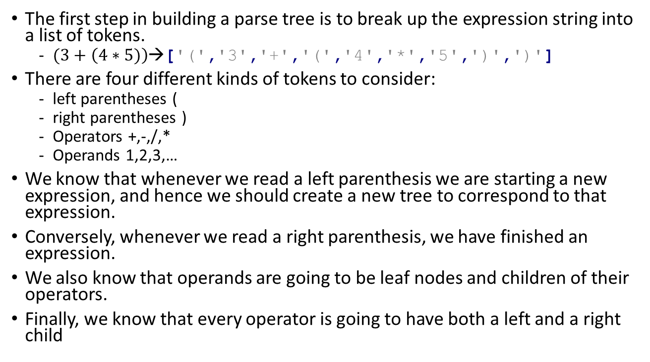
How to build a parse tree from a fully parenthesized mathematical expression
The first step in building a parse tree is to break up the expression string into a list of tokens.
$(3+\left(4∗5)\right)$→['(','3','+','(','4','*','5',')',')']
There are four different kinds of tokens to consider:
left parentheses (
right parentheses )
Operators +,-,/,*
Operands 1,2,3,…
We know that whenever we read a left parenthesis we are starting a new expression, and hence we should create a new tree to correspond to that expression.
Conversely, whenever we read a right parenthesis, we have finished an expression.
We also know that operands are going to be leaf nodes and children of their operators.
Finally, we know that every operator is going to have both a left and a right child

Slide 13
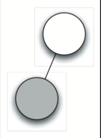
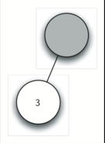
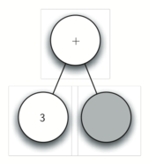

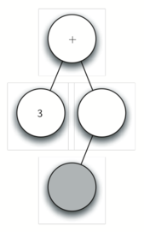
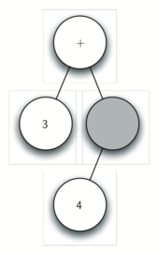
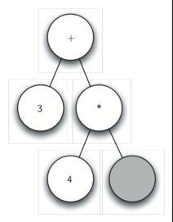
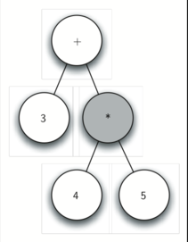
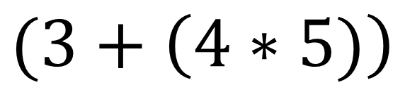
How to build a parse tree from a fully parenthesized mathematical expression
$$(3+\left(4∗5)\right)$$
The active/current node is shown in gray
a
b
c
d
e
f
g
h
Notes:
Using the information from the previous slide we can define four rules as follows:
If the current token is a '(', add a new node as the left child of the current node, and descend to the left child.
If the current token is in the list ['+','-','/','*'], set the root value of the current node to the operator represented by the current token. Add a new node as the right child of the current node and descend to the right child.
If the current token is a number, set the root value of the current node to the number and return to the parent.
If the current token is a ')', go to the parent of the current node.

Slide 14
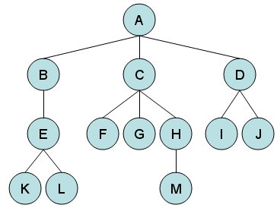
Tree Traversals
Tree traversals are commonly used patterns to visit all the nodes in a tree.
The difference between these patterns is the order in which each node is visited.
The most popular traversals methods are:
Depth First Traversals:
preorder
inorder
Postorder
Breadth First or Level Order Traversal

Slide 15
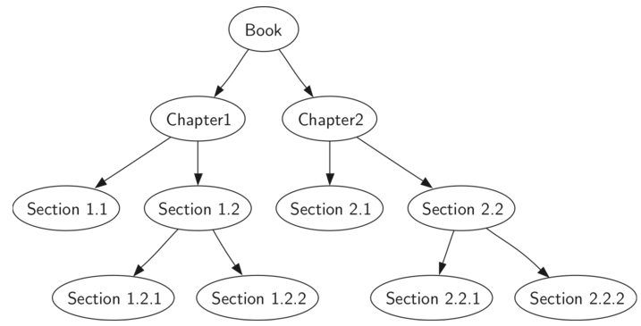
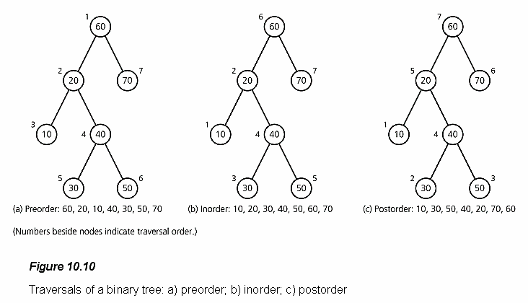
Depth first - Preorder
In a preorder traversal, we visit the root node first, then recursively do a preorder traversal of the left subtree, followed by a recursive preorder traversal of the right subtree.
Preorder (Root, Left, Right)
Typical example: parsing an object with chronological order (i.e. chapters in a book)
def preorder(tree):
if tree != None:
print(tree.getRootVal())
preorder(tree.getLeftChild())
preorder(tree.getRightChild())
Numbers beside nodes indicate traversal order

Slide 16

Depth first - Inorder
In an inorder traversal, we recursively do an inorder traversal on the left subtree, visit the root node, and finally do a recursive inorder traversal of the right subtree.
Inorder (Left, Root, Right)
Typical example: recover an original expression stored in a parse tree
def inorder(tree):
if tree != None:
inorder(tree.getLeftChild())
print(tree.getRootVal())
inorder(tree.getRightChild())
Numbers beside nodes indicate traversal order

Slide 17
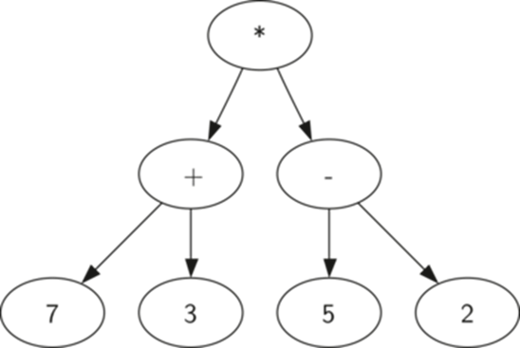
Depth first - Postorder
In a postorder traversal, we recursively do a postorder traversal of the left subtree and the right subtree followed by a visit to the root node.
Postorder (Left, Right, Root)
Typical example: evaluating a parse tree
def postorder(tree):
if tree != None:
postorder(tree.getLeftChild())
postorder(tree.getRightChild())
print(tree.getRootVal())
Numbers beside nodes indicate traversal order

Slide 18
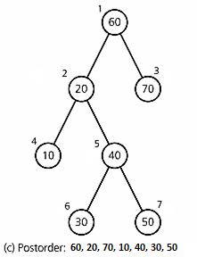
Breadth First (Level Order Traversal)
It starts at the tree root and explores the neighbor nodes first, before moving to the next level neighbors.
Typical example: scraping a web domain
Use a queue to store children nodes
Breath first:
Numbers beside nodes indicate traversal order

Slide 19
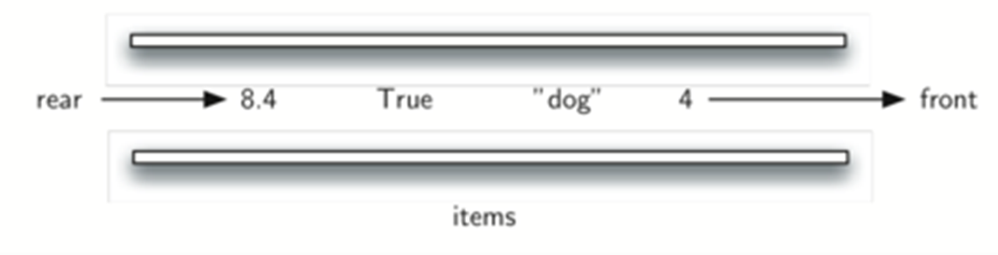
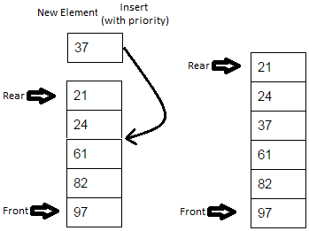
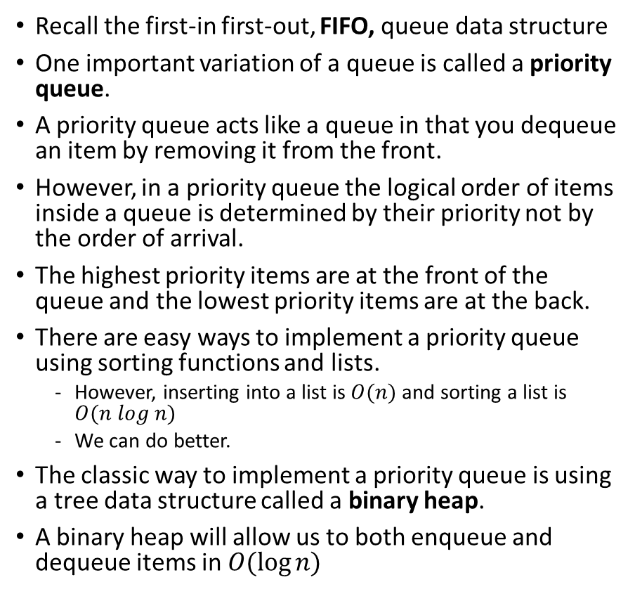
Priority Queues with Binary Heaps
Recall the first-in first-out, FIFO, queue data structure
One important variation of a queue is called a priority queue.
A priority queue acts like a queue in that you dequeue an item by removing it from the front.
However, in a priority queue the logical order of items inside a queue is determined by their priority not by the order of arrival.
The highest priority items are at the front of the queue and the lowest priority items are at the back.
There are easy ways to implement a priority queue using sorting functions and lists.
However, inserting into a list is $O(n)$ and sorting a list is $O(n log n)$
We can do better.
The classic way to implement a priority queue is using a tree data structure called a binary heap.
A binary heap will allow us to both enqueue and dequeue items in $O(\log{n)}$

Slide 20
Binary Heap Operations
The binary heap is interesting to study because when we diagram the heap it looks like a tree, but when we implement it we use only a single list as an internal representation.
The binary heap has two common variations:
the min heap, in which the smallest key is always at the front
the max heap, in which the largest key value is always at the front.
The basic operations we will implement for our binary heap are as follows:
BinaryHeap() creates a new, empty, binary heap.
insert(k) adds a new item to the heap.
findMin() returns the item with the minimum key value, leaving item in the heap.
delMin() returns the item with the minimum key value, removing the item from the heap.
isEmpty() returns true if the heap is empty, false otherwise.
size() returns the number of items in the heap.
buildHeap(list) builds a new heap from a list of keys.
A binary heap data structure is maintained by enforcing 2 properties:
The complete heap structure property
The heap order property

Slide 21
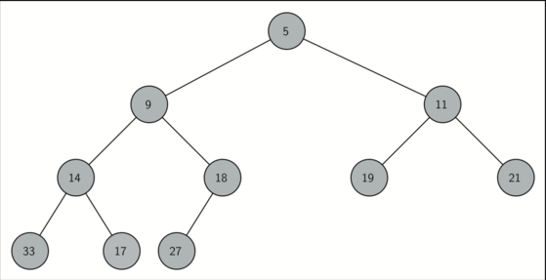
Binary Heap Implementation - The Complete Heap Structure Property
In order to make our heap work efficiently, we will take advantage of the logarithmic nature of the binary tree to represent our heap.
In order to guarantee logarithmic performance, we must keep our tree balanced.
A balanced binary tree has roughly the same number of nodes in the left and right subtrees of the root.
In our heap implementation we keep the tree balanced by creating a complete binary tree.
A complete binary tree is a tree in which each level has all of its nodes. The exception to this is the bottom level of the tree, which we fill in from left to right.

Slide 22
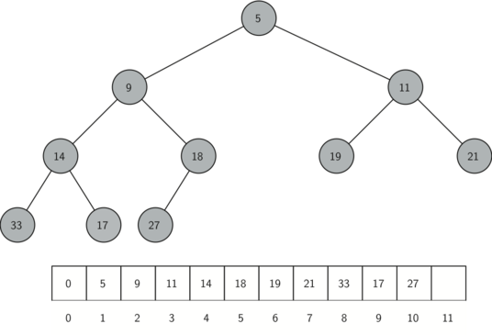
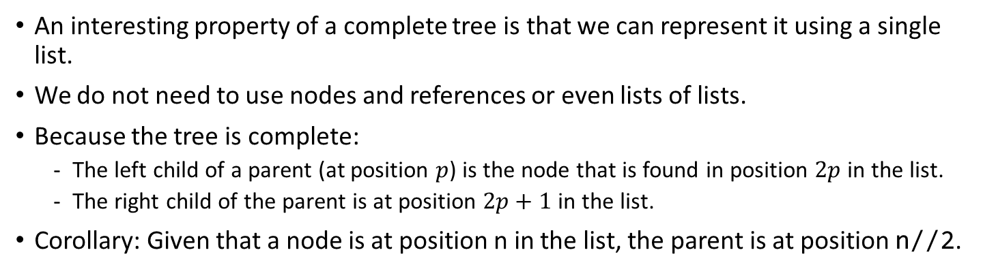
Binary Heap Implementation
An interesting property of a complete tree is that we can represent it using a single list.
We do not need to use nodes and references or even lists of lists.
Because the tree is complete:
The left child of a parent (at position $p$) is the node that is found in position $2p$in the list.
The right child of the parent is at position $2p+1$ in the list.
Corollary: Given that a node is at position n in the list, the parent is at position n//2.

Slide 23
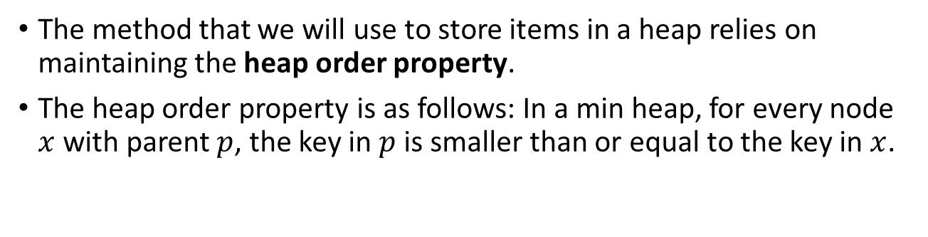
Binary Heap Implementation - The Heap Order Property
The method that we will use to store items in a heap relies on maintaining the heap order property.
The heap order property is as follows: In a min heap, for every node $x$ with parent $p$, the key in $p$ is smaller than or equal to the key in $x$.

Slide 24
Heap implementation
An entire binary heap can be represented by a single list
the constructor initializes the list and an attribute currentSize to keep track of the current size of the heap
notice that an empty binary heap has a single zero as the first element of heapList and that this zero is not used, but is there so that simple integer division (//) can be used in later methods.
class BinHeap:
def __init__(self):
self.heapList = [0]
self.currentSize = 0

Slide 25

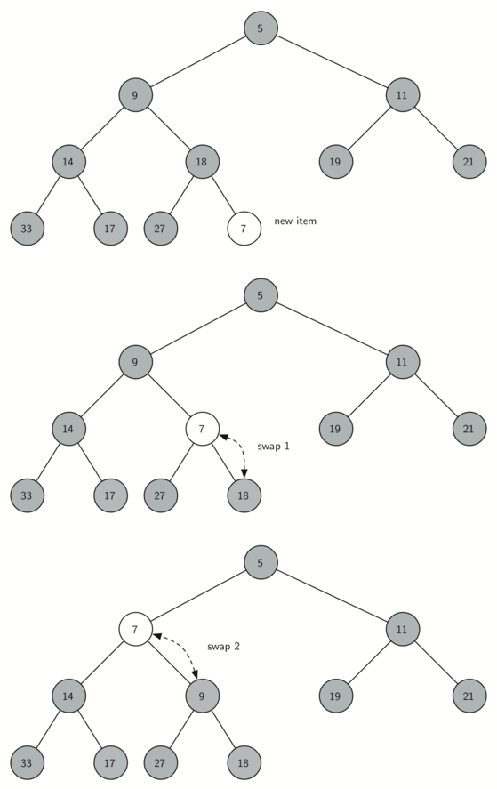
Heap operations - insert
The easiest, and most efficient, way to add an item to a list is to simply append the item to the end of the list.
Appending guarantees that we will maintain the complete heap structure property.
But appending will very likely violate the heap order property.
However, it is possible to write a method that will allow us to regain the heap order property by comparing the newly added item with its parent.
If the newly added item is less than its parent, then we can swap the item with its parent.
class BinHeap:
def __init__(self):
self.heapList = [0]
self.currentSize = 0
def percUp(self,i):
while i // 2 > 0:
if self.heapList[i] < self.heapList[i // 2]:
tmp = self.heapList[i // 2]
self.heapList[i // 2] = self.heapList[i]
self.heapList[i] = tmp
i = i // 2
def insert(self,k):
self.heapList.append(k)
self.currentSize = self.currentSize + 1
self.percUp(self.currentSize)

Slide 26
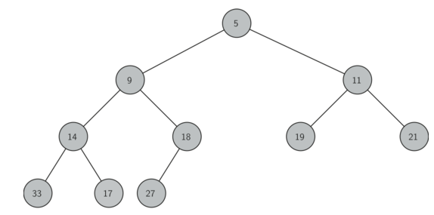
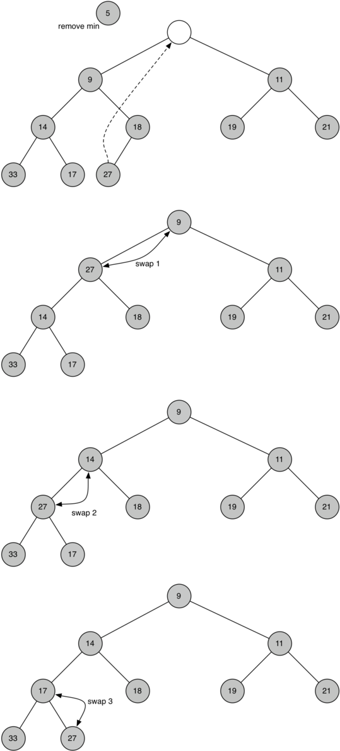
Heap operations – delete minimum
We can now look at the delMin method.
Since the heap property requires that the root of the tree be the smallest item in the tree, finding the minimum item is easy.
self.heapList[1]
The hard part of delMin is restoring full compliance with the complete heap structure and heap order properties after the root has been removed.
We can restore our heap in two steps.
Taking the last item in the list and moving it to the root position. Moving the last item maintains our complete heap structure property. However, we have probably destroyed the heap order property of our binary heap.
we will restore the heap order property by pushing the new root node down the tree to its proper position

